Slide 1
第十一章 表示和描述

Slide 2
图像表示与描述
目的:
用其他更合适的形式（而非图像本身）表示和描述图像中蕴含的有效信息
优点:
- 容易理解
- 储存需求少，处理速度快
- 可直接使用
可使用什么样的信息？
- 边界，形状
- 区域
- 纹理
- 区域间的关系

Slide 4
形状：链码
为什么要关注边界？
边界是物体形状的一种较好的表示，也对存储的需求也较少。

Slide 5
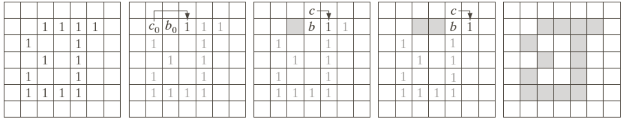
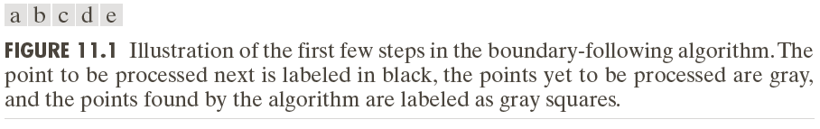
形状：链码
为什么要关注边界？
边界是物体形状的一种较好的表示，也对存储的需求也较少。
边界追踪：

Slide 6
形状：链码
边界追踪：
停止规则：重复，直到$b=b_{0}$ 并且下一个边界点是$b_{1}$。

Slide 7
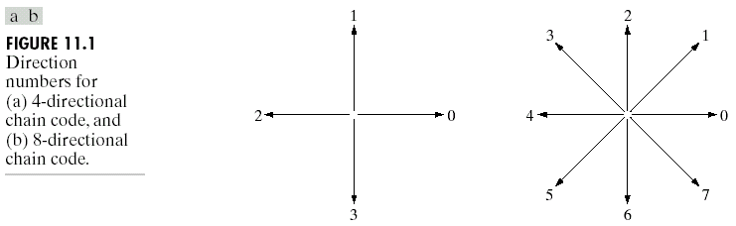
形状：链码
链码：
用特定长度和方向的直线段连续序列表示一个物体。
4-方向链码
8-方向链码
(Images from Rafael C.
Gonzalez and Richard E.
Wood, Digital Image
Processing, 2nd Edition.

Slide 8
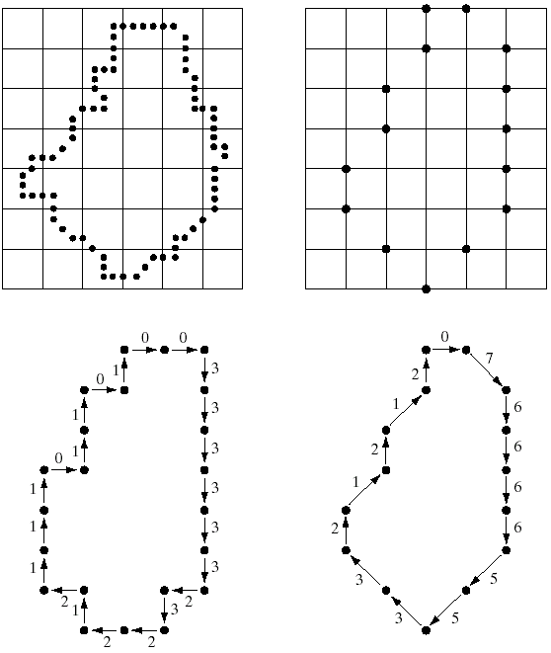
链码示例
物体边界
(重采样)
边界顶点
4-方向链码
8-方向链码
(Images from Rafael C. Gonzalez and Richard E.
Wood, Digital Image Processing, 2nd Edition.

Slide 9
链码的一阶导数
链码的问题:
链码顺序依赖于起点
解决方案: 将链码看作一个圆周序列，然后重新定义起点，使得新序列对应的数字的数值最小.
链码的一阶差分: 统计链码中连续两个元素方向发生改变的次数（逆时针方向）.
Example:
Chain code : The first
difference
0 → 1 1
0 → 2 2
0 → 3 3
2 → 3 1
2 → 0 2
2 → 1 3
Example:
- a chain code: 10103322
- The first difference = 3133030
- Treating a chain code as a
circular sequence, we get
the first difference = 33133030
1
2
0
3
The first difference is rotational
invariant.
Notes:
f‘=f(x+1)-f(x)，大数-小数，正常；小数-大数，=（小数+最大数）-大数

Slide 10
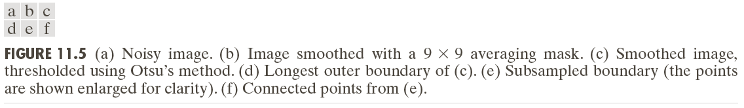
链码的一阶导数

Slide 11
00006066666666444444242222202202
00006066666666444444242222202202
00062600000006000006260000620626

Slide 12
Boundary Descriptors
1. Simple boundary descriptors:
we can use
- Length of the boundary
- The size of smallest circle or box that can totally
enclosing the object
2. Fourier descriptor

Slide 13
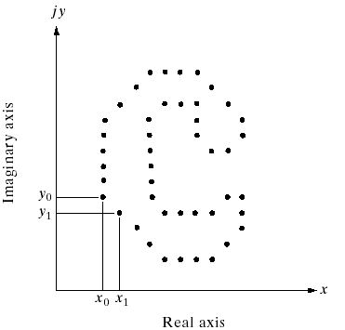
Fourier Descriptor
Fourier descriptor: view a coordinate (x,y) as a complex number
(x = real part and y = imaginary part) then apply the Fourier
transform to a sequence of boundary points.
Let s(k) be a coordinate
of a boundary point k :
Fourier descriptor :
Reconstruction formula
Boundary
points
(Images from Rafael C. Gonzalez and Richard E.
Wood, Digital Image Processing, 2nd Edition.
Notes:
对s(k)做DFT, a(u)是复数

Slide 14
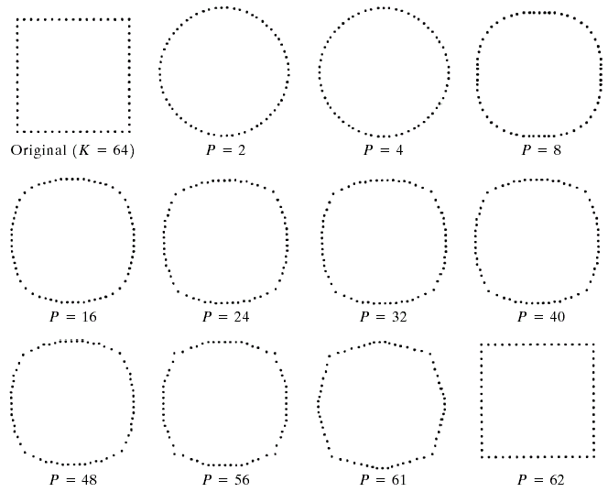
Example: Fourier Descriptor
Examples of reconstruction from Fourier descriptors
P is the number of
Fourier coefficients
used to reconstruct
the boundary
(Images from Rafael C. Gonzalez and Richard E.
Wood, Digital Image Processing, 2nd Edition.

Slide 15
Example: Fourier Descriptor

Slide 16
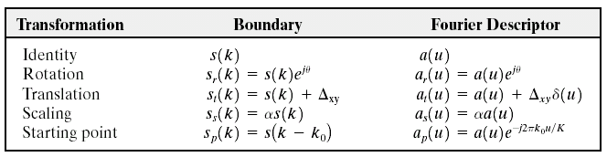
Fourier Descriptor Properties
Some properties of Fourier descriptors
(Images from Rafael C. Gonzalez and Richard E.
Wood, Digital Image Processing, 2nd Edition.

Slide 17
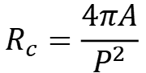
Regional Descriptors
Purpose: to describe regions or “areas”
1. Some simple regional descriptors
- area of the region
- length of the boundary (perimeter) of the region
- Compactness
- circularity ratio
where A(R) and P(R) = area and perimeter of region R
Example: a circle is the most compact shape with $C=1/4π$
$$R_{c}=\frac{4πA}{P^{2}}$$
2. Topological Descriptors
3. Moments of 2D Functions

Slide 18
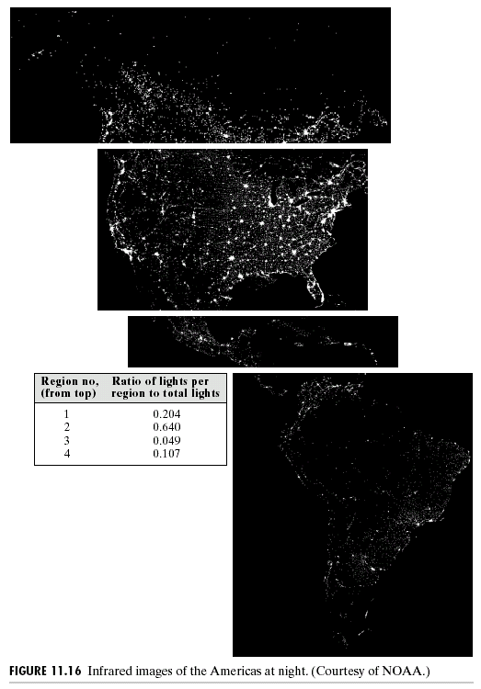
Example: Regional Descriptors
White pixels represent
“light of the cities”
ratio of lights per
Region no. region to total
lights
20.4%
64.0%
4.9%
10.7%
Infrared image of America at night
(Images from Rafael C. Gonzalez and Richard E.
Wood, Digital Image Processing, 2nd Edition.

Slide 19
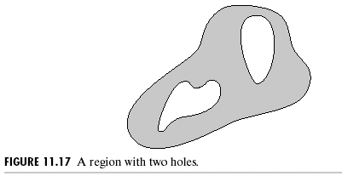
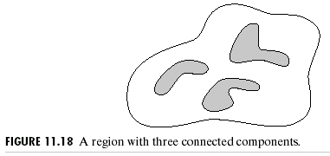
Topological Descriptors
Use to describe holes and connected components of the region
Euler number (E):
C = the number of connected
components
H = the number of holes
(Images from Rafael C. Gonzalez and Richard E.
Wood, Digital Image Processing, 2nd Edition.

Slide 20
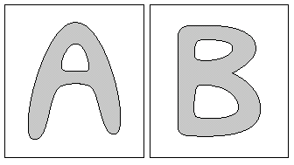
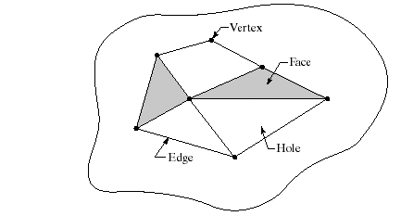
拓扑描述
E = -1
E = 0
Euler Formula
V = 顶点的数量
Q = 边的数量
F = 面的数量
E = -2

Slide 21
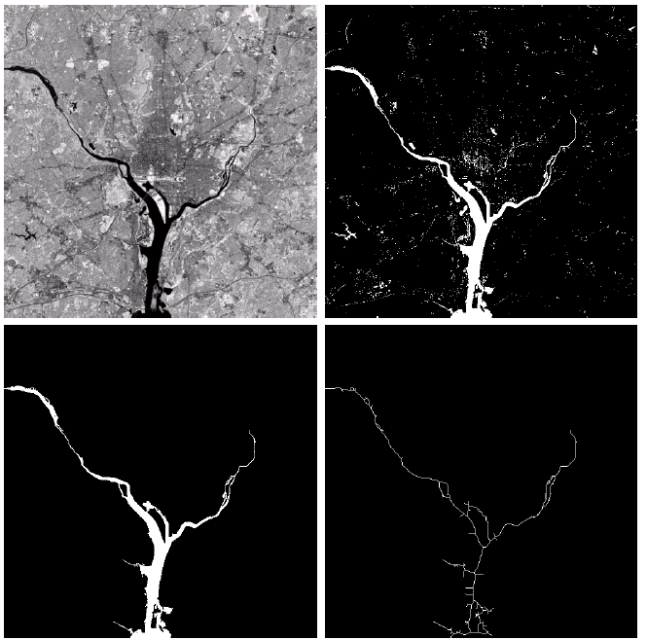
拓扑描述
原始图像:
华盛顿特区红外图像
灰度阈值处理
(1591个连通区域，39个孔洞)
Euler no. = 1552
最大连通区域
面积
(8479 Pixels)
(Hudson river)
细化结果
(Images from Rafael C. Gonzalez and Richard E.
Wood, Digital Image Processing, 2nd Edition.
Notes:
骨架可用来判断支流的长度

Slide 22
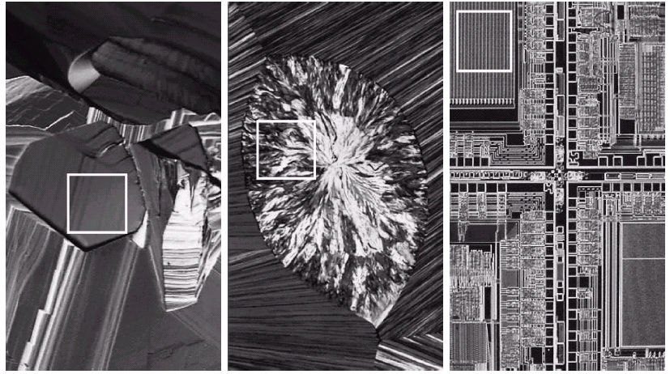
纹理描述符
目标: 描述区域纹理
示例: 光学显微图像
B
C
A
超导体
(smooth texture)
胆固醇
(coarse texture)
微处理器
(regular texture)
(Images from Rafael C. Gonzalez and Richard E.
Wood, Digital Image Processing, 2nd Edition.
Notes:
纹理没有统一的定义
超导、胆固醇、微处理器

Slide 23
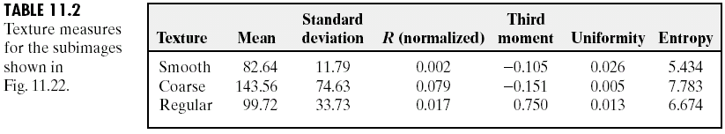
纹理描述的统计方法
基于图像直方图计算统计阶矩:
z = 灰度
p(z) = 概率密度函数
Example: The 2nd moment = variance → measure “smoothness”
The 3rd moment → measure “skewness”
The 4th moment → measure “uniformity” (flatness)
A
B
C
(Images from Rafael C. Gonzalez and Richard E.
Wood, Digital Image Processing, 2nd Edition.

Slide 24
纹理描述的傅里叶方法
概念: 将2D谱转换为1D图形
Original
image
Fourier
coefficient
image
FFT2D
+FFTSHIFT
Divide into areas
by angles
Divide into areas
by radius
Sum all pixels
in each area
Sum all pixels
in each area
Notes:
傅立叶频谱（1）频谱中突出的尖峰给出纹理模式的主要方向；（2）频率平面中尖峰的位置给出模式的基本空间周期；（3）采用滤波方法消除任何周期分量而留下非周期性图像元素，然后采用统计技术来描述。

Slide 25
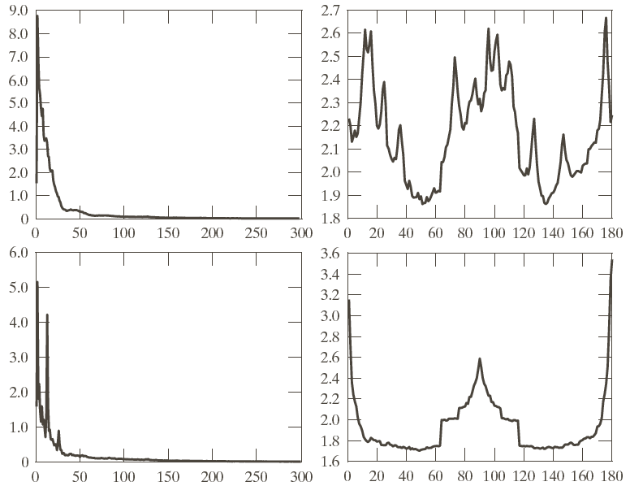

Slide 26
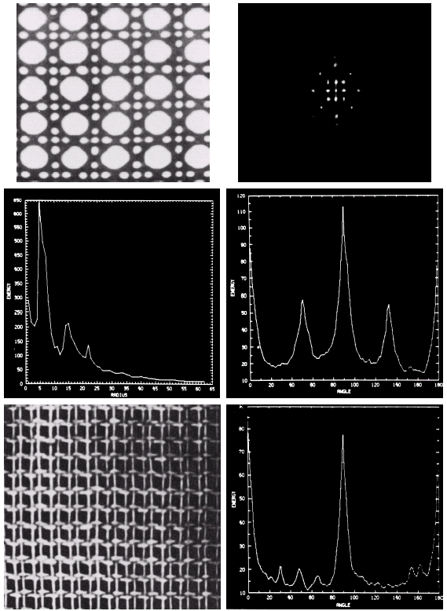
纹理描述的傅里叶方法
Original
image
2D Spectrum
(Fourier Tr.)
S(r)
S(q)
Another
image
Another S(q)
(Images from Rafael C.
Gonzalez and Richard E.
Wood, Digital Image
Processing, 2nd Edition.

Slide 27
2D函数的矩
The moment of order p + q
The central moments of order p + q

Slide 28
2D函数的不变矩
The normalized central moments of order p + q
where
Invariant moments: independent of rotation, translation,
scaling, and reflection

Slide 29
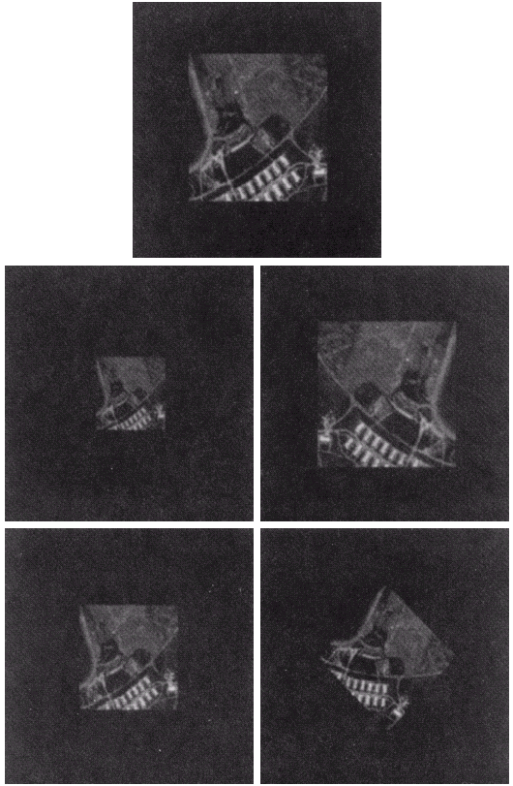
2D函数的不变矩
1. Original image
2. Half size
3. Mirrored
4. Rotated 2 degree
5. Rotated 45 degree
(Images from Rafael C. Gonzalez and Richard E.
Wood, Digital Image Processing, 2nd Edition.

Slide 30
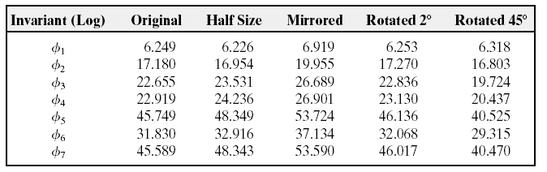
2D函数的不变矩
Invariant moments of images in the previous slide
原图
缩小
镜像
旋转
Invariant moments are independent of rotation, translation, scaling, and reflection
(Images from Rafael C. Gonzalez and Richard E.
Wood, Digital Image Processing, 2nd Edition.

Slide 31
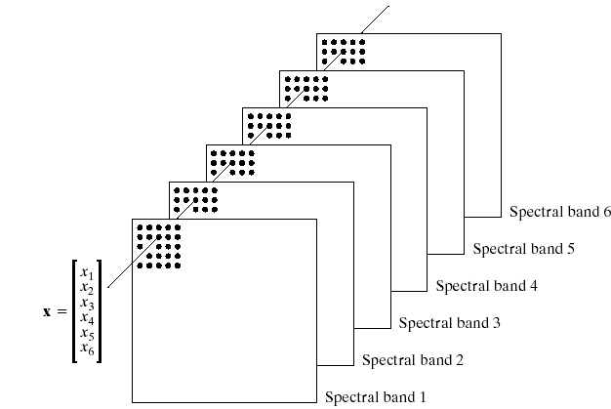
主成分描述
目的: 减少维度的同时，尽量保留更多信息。
Let
Mean:
Covariance matrix

Slide 32
主成分描述
Let
Where A is created from eigenvectors of C_{x} as follows
Row 1 contain the 1st eigenvector with the largest eigenvalue.
Row 2 contain the 2nd eigenvector with the 2nd largest eigenvalue.
….
Then we get
and
Then elements of are uncorrelated.

Slide 33

主成分描述
Eigenvector and eigenvalue of Matrix C are defined as
Let C be a matrix of size NxN and e be a vector of size Nx1.
If
Where $λ$ is a constant
We call e as an eigenvector and $λ$ as eigenvalue of C

Slide 34
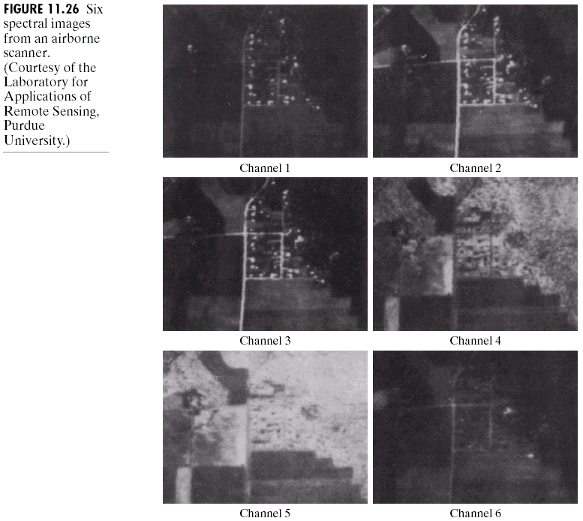
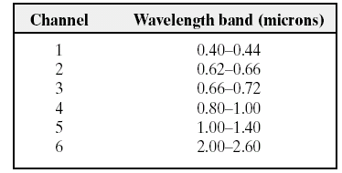
主成分描述
6 spectral images
from an airborne
Scanner.
(Images from Rafael C. Gonzalez and Richard E.
Wood, Digital Image Processing, 2nd Edition.

Slide 35
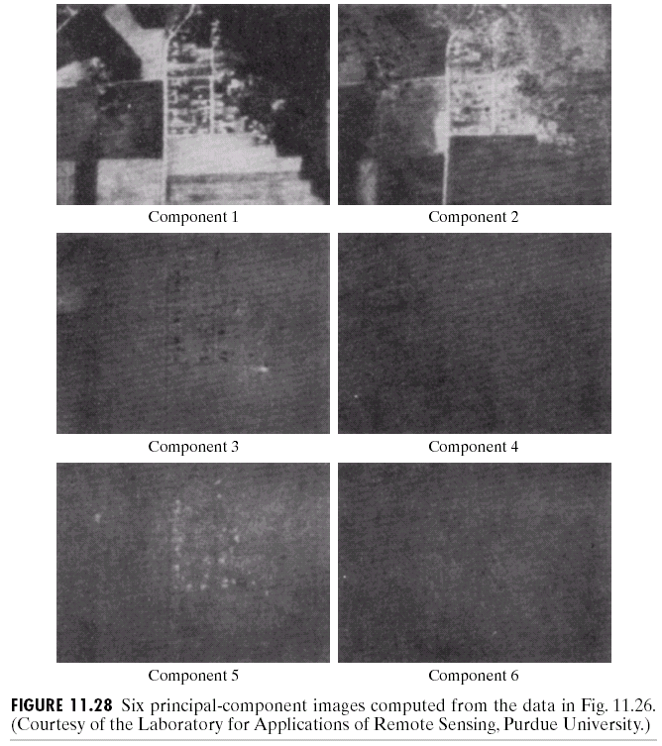
主成分描述
Component λ
3210
931.4
118.5
83.88
64.00
13.40
(Images from Rafael C. Gonzalez and Richard E.
Wood, Digital Image Processing, 2nd Edition.

Slide 36
主成分描述
Original image
After Hotelling transform

Slide 38
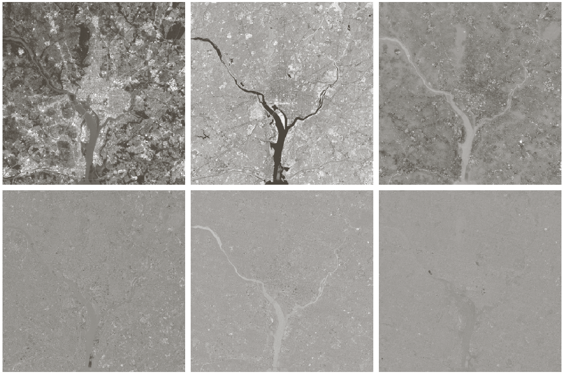

Slide 39
